Slide 1
人工智能
汤步洲、苏敬勇
哈尔滨工业大学（深圳）
计算机科学与技术学院
tangbuzhou@hit.edu.cn

Slide 2
人工智能
哈尔滨工业大学（深圳）
计算机科学与技术学院 汤步洲
tangbuzhou@hit.edu.cn

Slide 3
第 5 章 不确定性推理

Slide 4
主 要 内 容
5.1 概述
5.2 概率统计方法
5.3 Bayes网络

Slide 5
5.1.1 不确定性推理的含义
5.1 概述
什么是不确定性推理：
不确定性推理是指建立在不确定性知识和证据基础上的推理。包括不完备、不精确知识的推理，模糊知识的推理，非单调性推理等。泛指除精确推理以外的其它各种推理问题。
不确定性推理过程实际上是一种从不确定的初始证据出发，通过运用不确定性知识，最终推出具有一定不确定性但却又是合理或基本合理的结论的思维过程。为什么要采用不确定性推理
所需知识不完备、不精确
所需知识描述模糊
多种原因导致同一结论
解题方案不唯一

Slide 6
5.1.2 不确定性的表示
(1) 知识的不确定性的表示
考虑因素：问题的描述能力，推理中不确定性的计算
含义：知识的确定性程度，或动态强度
表示：用概率，[0,1]，0接近于假，1接近于假
用可信度，[-1,1]，大于0接近于真，小于0接近于假
(2) 证据不确定性的表示
证据的类型：按证据组织：基本证据，组合证据
按证据来源：初始证据，中间结论
表示方法：概率，可信度，模糊集等
基本证据：常与知识表示方法一致，如概率，可信度，模糊集等
组合证据：组合方式：析取的关系，合取的关系。
计算方法：基于基本证据
最大最小方法，概率方法，有界方法 等。

Slide 7
5.1.3 不确定性推理
推理过程实际上是不断寻找可用知识并加以运用的过程。1）寻找可用知识时，不确定性的知识和证据之间如何匹配？2）运用不确定性知识和证据进行推理时，如何更新不确定性的结论（即产生式规则表示中的假设）
（1）不确定性的匹配
含义
不确定的前提条件与不确定的事实匹配
问题
前提是不确定的，事实也是不确定的
方法
设计一个计算相似程度的算法，给出相似的限度
标志
相似度落在规定限度内为匹配，否则为不匹配

Slide 8
5.1.3 不确定性推理
（2）不确定性的更新
主要问题
① 如何用证据的不确定性去更新结论的不确定性
② 如何在推理中把初始证据的不确定性传递给最终结论
解决方法
对①，不同推理方法的解决方法不同
对②，不同推理方法的解决方法基本相同，即把当前结论及其不确定性作为新的结论放入综合数据库，依次传递，直到得出最终结论
5. 不确定性结论的合成
含义：多个不同知识推出同一结论，且不确定性程度不同
方法：视不同推理方法而定

Slide 9
5.4 不确定性推理类型
概率统
计方法
绝对概率方法
贝叶斯方法
数值
方法
模糊推
理方法
模型
方法
证据理论方法
粗糙集
方法
HMM方法
不确定性推理
非数值
方法
发生率计算
可信度方法
控制
方法
相关性制导回溯、机缘控制、启发式搜索等

Slide 10
5.1.4 不确定性推理类型
非数值方法
框架推理
语义网络推理
常识推理
不确定性推理
…
可信度方法
基于概率
主观Bayes方法
证据理论
概率方法
数值方法
概率推理
模糊方法

Slide 11
5.1.4 不确定性推理类型
数值方法
对不确定性的一种定量表示和处理方法
其研究及应用较多，已形成多种应用模型
非数值方法
除数值方法外的其它处理不确定性的模型方法
典型代表：“发生率计算方法”，它采用集合来描述和处理不确定性，且满足概率推理的性质

Slide 12
5.1.4 不确定性推理类型
概率统计方法
有完整、严密的数学理论
为不确定性的合成与传递提供了现成的数学公式
最早、最广泛地用于不确定性知识的表示与处理
已成为不确定性推理的重要手段
证据理论方法
1967年Dempster首次提出，1976年Shafer完善
可表示并处理“不知道”等不确定性信息

Slide 13
5.1.4 不确定性推理类型
模糊推理方法
可表示并处理由模糊性引起的不确定性
已广泛应用于不确定性推理
粗糙集理论方法
1981年Z. Pawlak首次提出
一种新的可表示并处理“含糊”等不确定性的数学方法
可用于不确定性推理、数据挖掘等领域

Slide 14
主 要 内 容
5.1 概述
5.2 概率统计方法
5.3 Bayes网络

Slide 15

5.2 概率统计方法
Probability
Random Variables
Joint and Marginal Distributions
Conditional Distribution
Product Rule, Chain Rule, Bayes’ Rule
Inference
Independence
IMPORTANT！！！
[These slides were created by Dan Klein and Pieter Abbeel for CS188 Intro to AI at UC Berkeley.
All CS188 materials are available at http://ai.berkeley.edu.]

Slide 16
Random Variables
A random variable is some aspect of the world about which we (may) have uncertainty
R = Is it raining?
T = Is it hot or cold?
D = How long will it take to drive to work?
L = Where is the Pac-Man?
We denote random variables with capital letters
Random variables have domains
R in {true, false} (often write as {+r, -r}, Boolean random variables)
T in {hot, cold} (Discrete random variables)
D in [0, ∞) (Continuous random variables)
L in possible locations, maybe {(0,0), (0,1), …}

Slide 17
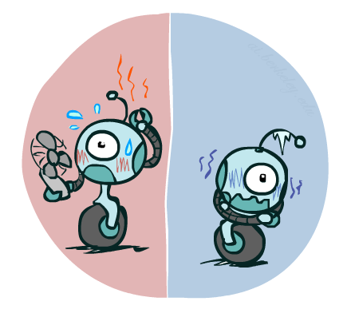
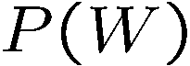
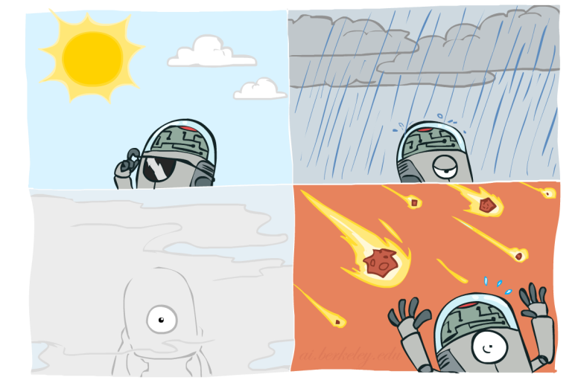
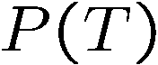
Probability Distributions
Associate a probability with each value
Temperature:
Weather:
W | P
sun | 0.6
rain | 0.1
fog | 0.3
meteor | 0.0
T | P
hot | 0.5
cold | 0.5
Notes:
Meteor-流星雨

Slide 18
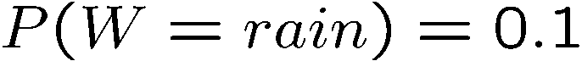
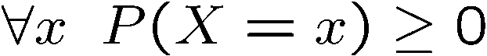
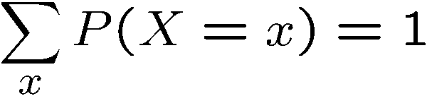
Probability Distributions
Unobserved random variables have distributions
A distribution is a TABLE of probabilities of values
A probability (lower case value) is a single number
Must have: and
Shorthand notation:
OK if all domain entries are unique
W | P
sun | 0.6
rain | 0.1
fog | 0.3
meteor | 0.0
T | P
hot | 0.5
cold | 0.5

Slide 19
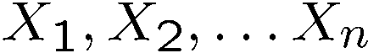
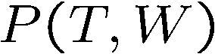
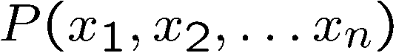
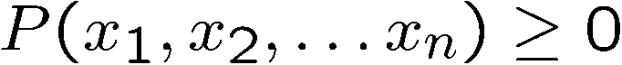
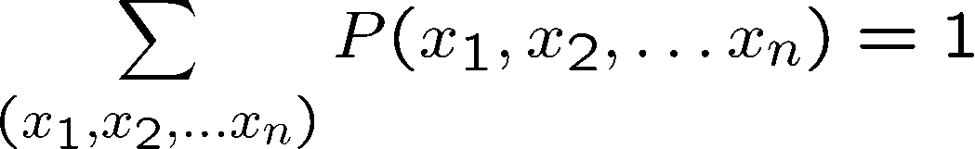
Joint Distributions
A joint distribution over a set of random variables:
specifies a real number for each assignment (or outcome or atomic event):
Must obey:
Size of distribution if n variables with domain sizes d?
For all but the smallest distributions, impractical to write out!
T | W | P
hot | sun | 0.4
hot | rain | 0.1
cold | sun | 0.2
cold | rain | 0.3

Slide 20
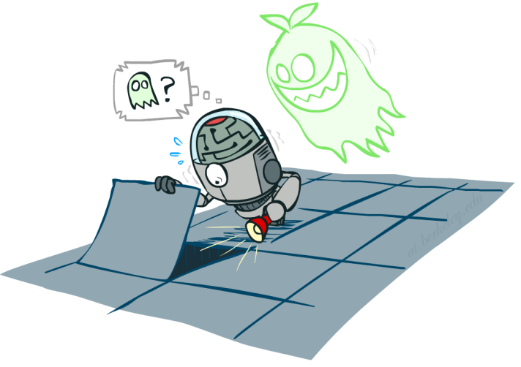

Probabilistic Models
Distribution over T,W
A probabilistic model is a joint distribution over a set of random variables
Probabilistic models:
(Random) variables with domains
Assignments are called outcomes
Joint distributions: say whether assignments (outcomes) are likely
Normalized: sum to 1.0
Ideally: only certain variables directly interact
Constraint satisfaction problems:
Variables with domains
Constraints: state whether assignments are possible
Ideally: only certain variables directly interact
T | W | P
hot | sun | 0.4
hot | rain | 0.1
cold | sun | 0.2
cold | rain | 0.3
Constraint over T,W
T | W | P
hot | sun | T
hot | rain | F
cold | sun | F
cold | rain | T

Slide 21
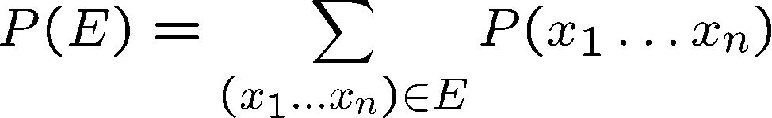
Events
An event is a set E of outcomes
From a joint distribution, we can calculate the probability of any event
Probability that it’s hot AND sunny?
Probability that it’s hot?
Probability that it’s hot OR sunny?
Typically, the events we care about are partial assignments, like P(T=hot)
T | W | P
hot | sun | 0.4
hot | rain | 0.1
cold | sun | 0.2
cold | rain | 0.3
Notes:
p(hot or sunny)=p(hot) + p(sunny) – p(hot, sunny)=0.4+0.1+0.2=0.7

Slide 22
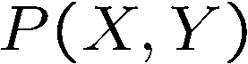
Quiz: Events
P(+x, +y) ?
P(+x) ?
P(-y OR +x) ?
X | Y | P
+x | +y | 0.2
+x | -y | 0.3
-x | +y | 0.4
-x | -y | 0.1

Slide 23
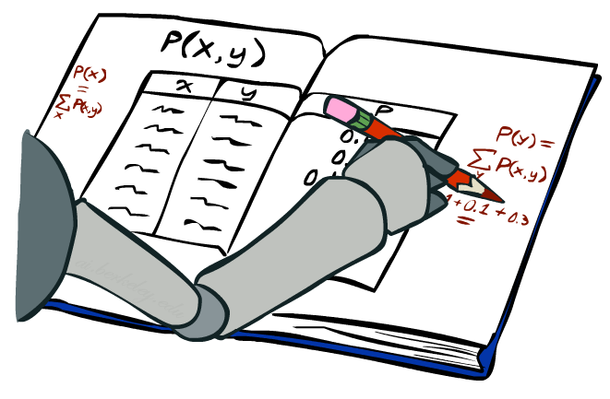
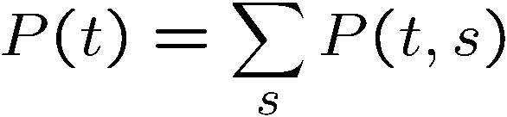
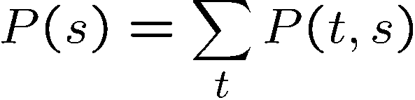
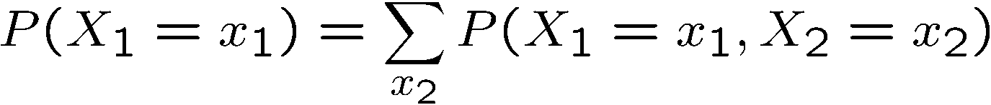
Marginal Distributions
Marginal distributions are sub-tables which eliminate variables
Marginalization (summing out): Combine collapsed rows by adding
T | P
hot | 0.5
cold | 0.5
T | W | P
hot | sun | 0.4
hot | rain | 0.1
cold | sun | 0.2
cold | rain | 0.3
W | P
sun | 0.6
rain | 0.4

Slide 24
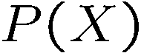

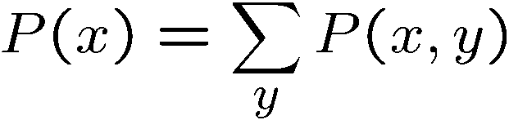
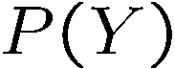
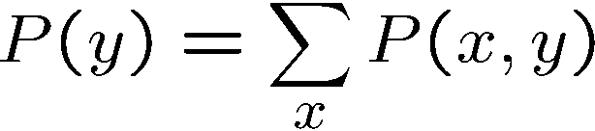
Quiz: Marginal Distributions
X | P
+x | 0.5
-x | 0.5
X | Y | P
+x | +y | 0.2
+x | -y | 0.3
-x | +y | 0.4
-x | -y | 0.1
Y | P
+y | 0.6
-y | 0.4

Slide 25
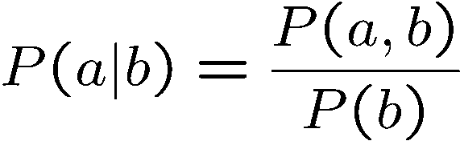
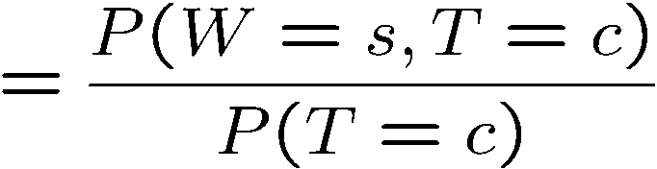
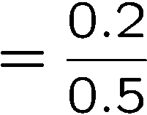
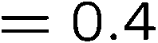
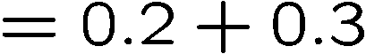
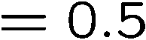
Conditional Probabilities
A simple relation between joint and conditional probabilities
In fact, this is taken as the definition of a conditional probability
P(a,b)
P(a)
P(b)
T | W | P
hot | sun | 0.4
hot | rain | 0.1
cold | sun | 0.2
cold | rain | 0.3

Slide 26
Quiz: Conditional Probabilities
P(+x | +y) ?
P(-x | +y) ?
P(-y | +x) ?
X | Y | P
+x | +y | 0.2
+x | -y | 0.3
-x | +y | 0.4
-x | -y | 0.1

Slide 27
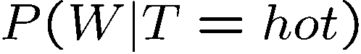

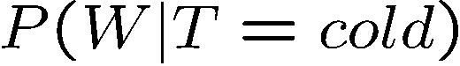
Conditional Distributions
Conditional distributions are probability distributions over some variables given fixed values of others
Conditional Distributions
Joint Distribution
W | P
sun | 0.8
rain | 0.2
T | W | P
hot | sun | 0.4
hot | rain | 0.1
cold | sun | 0.2
cold | rain | 0.3
W | P
sun | 0.4
rain | 0.6

Slide 28
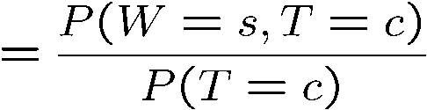
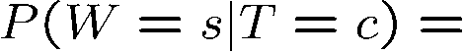
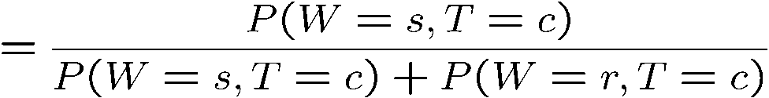
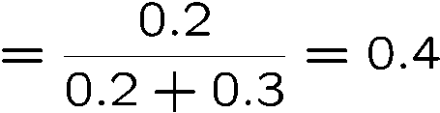
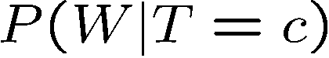
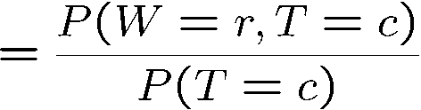
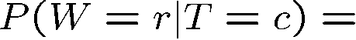
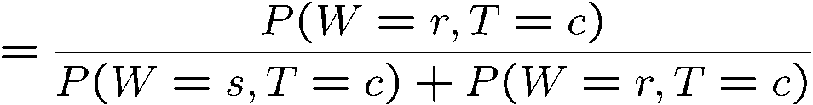
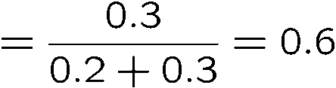
Normalization Trick
T | W | P
hot | sun | 0.4
hot | rain | 0.1
cold | sun | 0.2
cold | rain | 0.3
W | P
sun | 0.4
rain | 0.6

Slide 29
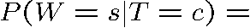
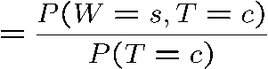
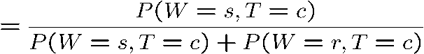
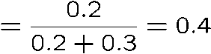
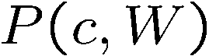
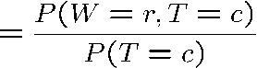
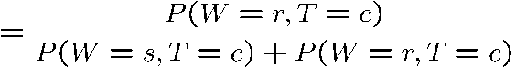

Normalization Trick
SELECT the joint probabilities matching the evidence
NORMALIZE the selection
(make it sum to one)
T | W | P
hot | sun | 0.4
hot | rain | 0.1
cold | sun | 0.2
cold | rain | 0.3
T | W | P
cold | sun | 0.2
cold | rain | 0.3
W | P
sun | 0.4
rain | 0.6

Slide 30
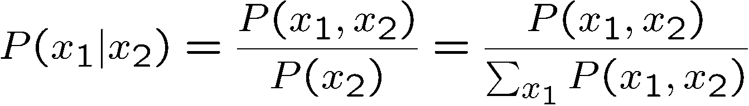
Normalization Trick
SELECT the joint probabilities matching the evidence
NORMALIZE the selection
(make it sum to one)
T | W | P
hot | sun | 0.4
hot | rain | 0.1
cold | sun | 0.2
cold | rain | 0.3
T | W | P
cold | sun | 0.2
cold | rain | 0.3
W | P
sun | 0.4
rain | 0.6
Why does this work? Sum of selection is P(evidence)! (P(T=c), here)

Slide 31
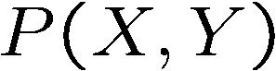
Quiz: Normalization Trick
P(X | Y=-y) ?
SELECT the joint probabilities matching the evidence
NORMALIZE the selection
(make it sum to one)
X | Y | P
+x | +y | 0.2
+x | -y | 0.3
-x | +y | 0.4
-x | -y | 0.1

Slide 32
To Normalize
(Dictionary) To bring or restore to a normal condition
Procedure:
Step 1: Compute Z = sum over all entries
Step 2: Divide every entry by Z
Example 1
All entries sum to ONE
Example 2
W | P
sun | 0.2
rain | 0.3
Normalize
W | P
sun | 0.4
rain | 0.6
T | W | P
hot | sun | 20
hot | rain | 5
cold | sun | 10
cold | rain | 15
T | W | P
hot | sun | 0.4
hot | rain | 0.1
cold | sun | 0.2
cold | rain | 0.3
Normalize
Z = 0.5
Z = 50

Slide 33
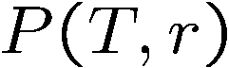

Normalization Trick
A trick to get a whole conditional distribution at once:
Select the joint probabilities matching the evidence
Normalize the selection (make it sum to one)
Why does this work? Sum of selection is P(evidence)! (P(r), here)
T | W | P
hot | sun | 0.4
hot | rain | 0.1
cold | sun | 0.2
cold | rain | 0.3
T | R | P
hot | rain | 0.1
cold | rain | 0.3
T | P
hot | 0.25
cold | 0.75
Select
Normalize

Slide 34
Conditional Distributions
Conditional distributions are probability distributions over some variables given fixed values of others
Conditional Distributions
Joint Distribution
W | P
sun | 0.8
rain | 0.2
T | W | P
hot | sun | 0.4
hot | rain | 0.1
cold | sun | 0.2
cold | rain | 0.3
W | P
sun | 0.4
rain | 0.6

Slide 35

Probabilistic Inference
Probabilistic inference: compute a desired probability from other known probabilities (e.g. conditional from joint)
We generally compute conditional probabilities
P(on time | no reported accidents) = 0.90
These represent the agent’s beliefs given the evidence
Probabilities change with new evidence:
P(on time | no accidents, 5 a.m.) = 0.95
P(on time | no accidents, 5 a.m., raining) = 0.80
Observing new evidence causes beliefs to be updated

Slide 36











Inference by Enumeration
* Works fine with multiple query variables, too
General case:
Evidence variables:
Query* variable:
Hidden variables:
We want:
All variables
Step 1: Select the entries consistent with the evidence
Step 2: Sum out H to get joint of Query and evidence
Step 3: Normalize

Slide 37
Inference by Enumeration
P(W)?
P(W | winter)?
P(W | winter, hot)?
S | T | W | P
summer | hot | sun | 0.30
summer | hot | rain | 0.05
summer | cold | sun | 0.10
summer | cold | rain | 0.05
winter | hot | sun | 0.10
winter | hot | rain | 0.05
winter | cold | sun | 0.15
winter | cold | rain | 0.20

Slide 38
Inference by Enumeration
Obvious problems:
Worst-case time complexity O(d^{n})
Space complexity O(d^{n}) to store the joint distribution

Slide 39



The Product Rule
Sometimes have conditional distributions but want the joint

Slide 40


The Product Rule
Example:
D | W | P
wet | sun | 0.1
dry | sun | 0.9
wet | rain | 0.7
dry | rain | 0.3
D | W | P
wet | sun | 0.08
dry | sun | 0.72
wet | rain | 0.14
dry | rain | 0.06
R | P
sun | 0.8
rain | 0.2

Slide 41

The Chain Rule
More generally, can always write any joint distribution as an incremental product of conditional distributions
Why is this always true?

Slide 42

Bayes’ Rule

Slide 43




Bayes’ Rule
Two ways to factor a joint distribution over two variables:
Dividing, we get:
Why is this at all helpful?
Lets us build one conditional from its reverse
Often one conditional is tricky but the other one is simple
Foundation of many systems we’ll see later (e.g. ASR, MT)
In the running for most important AI equation!
That’s my rule!

Slide 44
Inference with Bayes’ Rule
Example: Diagnostic probability from causal probability:
Example:
M: meningitis, S: stiff neck
Note: posterior probability of meningitis still very small
Note: you should still get stiff necks checked out! Why?
Example
givens
Notes:
Meningitis-脑膜炎
Stiff neck-斜颈、歪脖子

Slide 45
Quiz: Bayes’ Rule
D | W | P
wet | sun | 0.1
dry | sun | 0.9
wet | rain | 0.7
dry | rain | 0.3
Given:
What is P(W | dry) ?
R | P
sun | 0.8
rain | 0.2

Slide 46
主 要 内 容
5.1 概述
5.2 概率统计方法
5.3 Bayes网络

Slide 47

Bayes’ Nets: Independence

Slide 48


Probability Recap
Conditional probability
Product rule
Chain rule
X, Y independent if and only if:
X and Y are conditionally independent given Z if and only if:
Notes:
Probability Recap-概率知识概述

Slide 49

Bayes’ Nets
A Bayes’ net is an
efficient encoding
of a probabilistic
model of a domain
Questions we can ask:
Inference: given a fixed BN, what is P(X | e)?
Representation: given a BN graph, what kinds of distributions can it encode?
Modeling: what BN is most appropriate for a given domain?

Slide 50




Bayes’ Net Semantics
A directed, acyclic graph, one node per random variable
A conditional probability table (CPT) for each node
A collection of distributions over X, one for each combination of parents’ values
Bayes’ nets implicitly encode joint distributions
As a product of local conditional distributions
To see what probability a BN gives to a full assignment, multiply all the relevant conditionals together:

Slide 51


Example: Alarm Network
B | P(B)
+b | 0.001
-b | 0.999
B
E
E | P(E)
+e | 0.002
-e | 0.998
A
A | J | P(J|A)
+a | +j | 0.9
+a | -j | 0.1
-a | +j | 0.05
-a | -j | 0.95
A | M | P(M|A)
+a | +m | 0.7
+a | -m | 0.3
-a | +m | 0.01
-a | -m | 0.99
B | E | A | P(A|B,E)
+b | +e | +a | 0.95
+b | +e | -a | 0.05
+b | -e | +a | 0.94
+b | -e | -a | 0.06
-b | +e | +a | 0.29
-b | +e | -a | 0.71
-b | -e | +a | 0.001
-b | -e | -a | 0.999
J
M
Notes:
demo

Slide 52

Example: Alarm Network
B | P(B)
+b | 0.001
-b | 0.999
B
E
E | P(E)
+e | 0.002
-e | 0.998
A
A | J | P(J|A)
+a | +j | 0.9
+a | -j | 0.1
-a | +j | 0.05
-a | -j | 0.95
A | M | P(M|A)
+a | +m | 0.7
+a | -m | 0.3
-a | +m | 0.01
-a | -m | 0.99
B | E | A | P(A|B,E)
+b | +e | +a | 0.95
+b | +e | -a | 0.05
+b | -e | +a | 0.94
+b | -e | -a | 0.06
-b | +e | +a | 0.29
-b | +e | -a | 0.71
-b | -e | +a | 0.001
-b | -e | -a | 0.999
J
M
Notes:
demo

Slide 53


Size of a Bayes’ Net
How big is a joint distribution over N Boolean variables?
2^{N}
How big is an N-node net if nodes have up to k parents?
O(N * 2^{k+1})
Both give you the power to calculate
BNs: Huge space savings!
Also easier to elicit local CPTs
Also faster to answer queries (coming)

Slide 54

Bayes’ Nets
Representation
Conditional Independences
Probabilistic Inference
Learning Bayes’ Nets from Data

Slide 55



Conditional Independence
X and Y are independent if
X and Y are conditionally independent given Z
(Conditional) independence is a property of a distribution
Example:

Slide 56

Bayes Nets: Assumptions
Assumptions we are required to make to define the Bayes net when given the graph:
Beyond above “chain rule → Bayes net” conditional independence assumptions
Often additional conditional independences
They can be read off the graph
Important for modeling: understand assumptions made when choosing a Bayes net graph
Notes:
Important for modeling: understanding which assumptions you are making!

Slide 57
Example
X
Y
Z
W
Conditional independence assumptions directly from simplifications in chain rule:
Additional implied conditional independence assumptions?

Slide 58
Independence in a BN
Important question about a BN:
Are two nodes independent given certain evidence?
If yes, can prove using algebra (tedious in general)
If no, can prove with a counter example
Example:
Question: are X and Z necessarily independent?
Answer: no. Example: low pressure causes rain, which causes traffic.
X can influence Z, Z can influence X (via Y)
Addendum: they could be independent: how?
X
Y
Z
Notes:
Addendum-附录，补充

Slide 59

D-separation: Outline

Slide 60
D-separation: Outline
Study independence properties for triples
Analyze complex cases in terms of member triples
D-separation: a condition / algorithm for answering such queries

Slide 61

Causal Chains
This configuration is a “causal chain”
Guaranteed X independent of Z ? No!
One example set of CPTs for which X is not independent of Z is sufficient to show this independence is not guaranteed.
Example:
Low pressure causes rain causes traffic,
high pressure causes no rain causes no
traffic
In numbers:
P( +y | +x ) = 1, P( -y | - x ) = 1,
P( +z | +y ) = 1, P( -z | -y ) = 1
X: Low pressure Y: Rain Z: Traffic

Slide 62



Causal Chains
This configuration is a “causal chain”
Guaranteed X independent of Z given Y?
Evidence along the chain “blocks” the influence
X: Low pressure Y: Rain Z: Traffic
Yes!

Slide 63

Common Cause
This configuration is a “common cause”
Guaranteed X independent of Z ? No!
One example set of CPTs for which X is not independent of Z is sufficient to show this independence is not guaranteed.
Example:
Project due causes both forums busy
and lab full
In numbers:
P( +x | +y ) = 1, P( -x | -y ) = 1,
P( +z | +y ) = 1, P( -z | -y ) = 1
Y: Project due
X: Forums busy
Z: Lab full

Slide 64

Common Cause
This configuration is a “common cause”
Guaranteed X and Z independent given Y?
Observing the cause blocks influence between effects.
Y: Project due
X: Forums busy
Z: Lab full
Yes!

Slide 65

Common Effect
Last configuration: two causes of one effect (v-structures)
Are X and Y independent?
Yes: the ballgame and the rain cause traffic, but they are not correlated
Still need to prove they must be (try it!)
Are X and Y independent given Z?
No: seeing traffic puts the rain and the ballgame in competition as explanation.
This is backwards from the other cases
Observing an effect activates influence between possible causes.
X: Raining
Y: Ballgame
Z: Traffic
Notes:
Ballgame-球赛
p(x,y,z) = p(x)*p(y)*p(z|x,y)=p(x)*p(y)*p(x,y,z)/p(x,y) => p(x,y)=p(x)*p(y)
Traffic:10次，X: 6次，Y: 7次，XY: 3次
P(XY|Z)=0.3，p(X)=0.6，p(Y)=0.7

Slide 66

Common Effect

Slide 67

The General Case

Slide 68

The General Case
General question: in a given BN, are two variables independent (given evidence)?
Solution: analyze the graph
Any complex example can be broken
into repetitions of the three canonical cases

Slide 69


Reachability
L
Recipe: shade evidence nodes, look for paths in the resulting graph
Attempt 1: if two nodes are connected by an undirected path not blocked by a shaded node, they are conditionally independent
Almost works, but not quite
Where does it break?
Answer: the v-structure at T doesn’t count as a link in a path unless “active”
R
B
D
T

Slide 70

Active / Inactive Paths
Question: Are X and Y conditionally independent given evidence variables {Z}?
Yes, if X and Y “d-separated” by Z
Consider all (undirected) paths from X to Y
No active paths = independence!
A path is active if each triple is active:
Causal chain A → B → C where B is unobserved (either direction)
Common cause A ← B → C where B is unobserved
Common effect (aka v-structure)
A → B ← C where B or one of its descendents is observed
All it takes to block a path is a single inactive segment
Active Triples
Inactive Triples
Notes:
当下面两个条件中有一个被满足，说明一个Trail（X1-X2-…-Xn）关于Z是Active的： （1）对于任意V型结构：Xi->X<-Xj，X属于Z，或X的子孙节点属于Z （2）没有Xi属于Z（Z不为空）

Slide 71



D-Separation
?
Query:
Check all (undirected!) paths between and
If one or more active, then independence not guaranteed
Otherwise (i.e. if all paths are inactive),
then independence is guaranteed

Slide 72



Example
Yes
R
B
T
T’
Notes:
T’: traffic report

Slide 73





Example
L
Yes
R
B
Yes
D
T
Yes
T’

Slide 74



Example
Variables:
R: Raining
T: Traffic
D: Roof drips
S: I’m sad
Questions:
R
T
D
S
Yes

Slide 75

D-separation and Markov Blanket
Theorem: In a Bayesian network, a variable X is conditionally independent of all other variables given its Markov blanket.
Because the Markov blanket of X d-separates X from all other nodes.
Notes:
当下面两个条件中有一个被满足，说明一个Trail（X1-X2-…-Xn）关于Z是Active的： （1）对于任意V型结构：Xi->X<-Xj，X属于Z，或X的子孙节点属于Z （2）没有Xi属于Z（Z不为空）

Slide 76

Structure Implications
Given a Bayes net structure, can run d-separation algorithm to build a complete list of conditional independences that are necessarily true of the form
This list determines the set of probability distributions that can be represented

Slide 77

Computing All Independences
Y
X
Z
Y
X
Z
X
Z
Y
Y
X
Z

Slide 78
Topology Limits Distributions
Given some graph topology G, only certain joint distributions can be encoded
The graph structure guarantees certain (conditional) independences
(There might be more independence)
Adding arcs increases the set of distributions, but has several costs
Full conditioning can encode any distribution
Y
Y
X
Z
X
Z
Y
X
Z
Y
X
Z
Y
Y
Y
X
Z
X
Z
X
Z
Y
Y
Y
X
Z
X
Z
X
Z

Slide 79
Bayes’ Nets
Representation
Conditional Independences
Probabilistic Inference
Enumeration (exact, exponential complexity)
Variable elimination (exact, worst-case
exponential complexity, often better)
Probabilistic inference is NP-complete
Sampling (approximate)
Learning Bayes’ Nets from Data

Slide 80
Bayes’ Net Representation
A directed, acyclic graph, one node per random variable
A conditional probability table (CPT) for each node
A collection of distributions over X, one for each combination of parents’ values
Bayes’ nets implicitly encode joint distributions
As a product of local conditional distributions
To see what probability a BN gives to a full assignment, multiply all the relevant conditionals together:

Slide 81

Example: Alarm Network
B | P(B)
+b | 0.001
-b | 0.999
E | P(E)
+e | 0.002
-e | 0.998
Burglary
Earthqk
Alarm
B | E | A | P(A|B,E)
+b | +e | +a | 0.95
+b | +e | -a | 0.05
+b | -e | +a | 0.94
+b | -e | -a | 0.06
-b | +e | +a | 0.29
-b | +e | -a | 0.71
-b | -e | +a | 0.001
-b | -e | -a | 0.999
John calls
Mary calls
A | J | P(J|A)
+a | +j | 0.9
+a | -j | 0.1
-a | +j | 0.05
-a | -j | 0.95
A | M | P(M|A)
+a | +m | 0.7
+a | -m | 0.3
-a | +m | 0.01
-a | -m | 0.99
Notes:
Demo:
Draw network
Specify the CPTs
Then query, e.g., Mary Calls --- not something we specified, inference computed this for us
P(B) = ?
P(B | +e) = ?
Independence
P(B) = ?
P(B | +m) = ?
Show explaining away

Slide 82
Example: Alarm Network
B | P(B)
+b | 0.001
-b | 0.999
B
E
E | P(E)
+e | 0.002
-e | 0.998
A
A | J | P(J|A)
+a | +j | 0.9
+a | -j | 0.1
-a | +j | 0.05
-a | -j | 0.95
A | M | P(M|A)
+a | +m | 0.7
+a | -m | 0.3
-a | +m | 0.01
-a | -m | 0.99
B | E | A | P(A|B,E)
+b | +e | +a | 0.95
+b | +e | -a | 0.05
+b | -e | +a | 0.94
+b | -e | -a | 0.06
-b | +e | +a | 0.29
-b | +e | -a | 0.71
-b | -e | +a | 0.001
-b | -e | -a | 0.999
J
M
Notes:
demo

Slide 83

Example: Alarm Network
B | P(B)
+b | 0.001
-b | 0.999
B
E
E | P(E)
+e | 0.002
-e | 0.998
A
A | J | P(J|A)
+a | +j | 0.9
+a | -j | 0.1
-a | +j | 0.05
-a | -j | 0.95
A | M | P(M|A)
+a | +m | 0.7
+a | -m | 0.3
-a | +m | 0.01
-a | -m | 0.99
B | E | A | P(A|B,E)
+b | +e | +a | 0.95
+b | +e | -a | 0.05
+b | -e | +a | 0.94
+b | -e | -a | 0.06
-b | +e | +a | 0.29
-b | +e | -a | 0.71
-b | -e | +a | 0.001
-b | -e | -a | 0.999
J
M
Notes:
demo

Slide 84

Bayes’ Nets
Representation
Conditional Independences
Probabilistic Inference
Enumeration (exact, exponential complexity)
Variable elimination (exact, worst-case exponential complexity, often better)
Inference is NP-complete
Sampling (approximate)
Learning Bayes’ Nets from Data

Slide 85

Inference
Inference: calculating some useful quantity from a joint probability distribution
Examples:
Posterior probability
Most likely explanation:

Slide 86


Inference by Enumeration
* Works fine with multiple query variables, too
General case:
Evidence variables:
Query* variable:
Hidden variables:
We want:
All variables
Step 1: Select the entries consistent with the evidence
Step 2: Sum out H to get joint of Query and evidence
Step 3: Normalize

Slide 87
Inference by Enumeration in Bayes’ Net
Given unlimited time, inference in BNs is easy
Reminder of inference by enumeration by example:
B
E
A
J
M

Slide 88

Inference by Enumeration?

Slide 89


Inference by Enumeration vs. Variable Elimination
Why is inference by enumeration so slow?
You join up the whole joint distribution before you sum out the hidden variables
Idea: interleave joining and marginalizing!
Called “Variable Elimination”
Still NP-hard, but usually much faster than inference by enumeration
First we’ll need some new notation: factors

Slide 90

Factor Zoo

Slide 91


Factor Zoo I
Joint distribution: P(X,Y)
Entries P(x,y) for all x, y
Sums to 1
Selected joint: P(x,Y)
A slice of the joint distribution
Entries P(x,y) for fixed x, all y
Sums to P(x)
Number of capitals = dimensionality of the table
T | W | P
hot | sun | 0.4
hot | rain | 0.1
cold | sun | 0.2
cold | rain | 0.3
T | W | P
cold | sun | 0.2
cold | rain | 0.3

Slide 92






Factor Zoo II
Single conditional: P(Y | x)
Entries P(y | x) for fixed x, all y
Sums to 1
Family of conditionals:
P(X |Y)
Multiple conditionals
Entries P(x | y) for all x, y
Sums to |Y|
T | W | P
cold | sun | 0.4
cold | rain | 0.6
T | W | P
hot | sun | 0.8
hot | rain | 0.2
cold | sun | 0.4
cold | rain | 0.6

Slide 93




Factor Zoo III
Specified family: P( y | X )
Entries P(y | x) for fixed y,
but for all x
Sums to … who knows!
T | W | P
hot | rain | 0.2
cold | rain | 0.6

Slide 94




Factor Zoo Summary
In general, when we write P(Y₁ … Y_{N} | X₁ … X_{M})
It is a “factor,” a multi-dimensional array
Its values are P(y₁ … y_{N} | x₁ … x_{M})
Any assigned (=lower-case) X or Y is a dimension missing (selected) from the array

Slide 95



Example: Traffic Domain
Random Variables
R: Raining
T: Traffic
L: Late for class!
+r | 0.1
-r | 0.9
R
T
+r | +t | 0.8
+r | -t | 0.2
-r | +t | 0.1
-r | -t | 0.9
L
+t | +l | 0.3
+t | -l | 0.7
-t | +l | 0.1
-t | -l | 0.9

Slide 96

Variable Elimination (VE)

Slide 97







Inference by Enumeration: Procedural Outline
Track objects called factors
Initial factors are local CPTs (one per node)
Any known values are selected
E.g. if we know , the initial factors are
Procedure: Join all factors, then eliminate all hidden variables
+r | 0.1
-r | 0.9
+r | +t | 0.8
+r | -t | 0.2
-r | +t | 0.1
-r | -t | 0.9
+t | +l | 0.3
+t | -l | 0.7
-t | +l | 0.1
-t | -l | 0.9
+r | 0.1
-r | 0.9
+r | +t | 0.8
+r | -t | 0.2
-r | +t | 0.1
-r | -t | 0.9
+t | +l | 0.3
-t | +l | 0.1

Slide 98





Operation 1: Join Factors
First basic operation: joining factors
Combining factors:
Just like a database join
Get all factors over the joining variable
Build a new factor over the union of the variables involved
Example: Join on R
Computation for each entry: pointwise products
R
+r | 0.1
-r | 0.9
+r | +t | 0.8
+r | -t | 0.2
-r | +t | 0.1
-r | -t | 0.9
+r | +t | 0.08
+r | -t | 0.02
-r | +t | 0.09
-r | -t | 0.81
R,T
T

Slide 99

Example: Multiple Joins

Slide 100



Example: Multiple Joins
+r | 0.1
-r | 0.9
R
Join R
Join T
+r | +t | 0.08
+r | -t | 0.02
-r | +t | 0.09
-r | -t | 0.81
R, T, L
T
+r | +t | 0.8
+r | -t | 0.2
-r | +t | 0.1
-r | -t | 0.9
R, T
+r | +t | +l | 0.024
+r | +t | -l | 0.056
+r | -t | +l | 0.002
+r | -t | -l | 0.018
-r | +t | +l | 0.027
-r | +t | -l | 0.063
-r | -t | +l | 0.081
-r | -t | -l | 0.729
L
L
+t | +l | 0.3
+t | -l | 0.7
-t | +l | 0.1
-t | -l | 0.9
+t | +l | 0.3
+t | -l | 0.7
-t | +l | 0.1
-t | -l | 0.9

Slide 101



Operation 2: Eliminate
Second basic operation: marginalization
Take a factor and sum out a variable
Shrinks a factor to a smaller one
A projection operation
Example:
+r | +t | 0.08
+r | -t | 0.02
-r | +t | 0.09
-r | -t | 0.81
+t | 0.17
-t | 0.83

Slide 102



Multiple Elimination
R, T, L
T, L
L
+r | +t | +l | 0.024
+r | +t | -l | 0.056
+r | -t | +l | 0.002
+r | -t | -l | 0.018
-r | +t | +l | 0.027
-r | +t | -l | 0.063
-r | -t | +l | 0.081
-r | -t | -l | 0.729
Sum
out R
Sum
out T
+t | +l | 0.051
+t | -l | 0.119
-t | +l | 0.083
-t | -l | 0.747
+l | 0.134
-l | 0.886

Slide 103

Thus Far: Multiple Join, Multiple Eliminate (= Inference by Enumeration)

Slide 104

Marginalizing Early (= Variable Elimination)

Slide 105
Traffic Domain
R
Inference by Enumeration
Variable Elimination
T
L
Join on r
Join on r
Join on t
Eliminate r
Eliminate r
Join on t
Eliminate t
Eliminate t

Slide 106


Marginalizing Early! (aka VE)
Join R
Sum out R
Join T
Sum out T
+r | +t | 0.08
+r | -t | 0.02
-r | +t | 0.09
-r | -t | 0.81
+r | 0.1
-r | 0.9
+t | 0.17
-t | 0.83
R
T
T, L
R, T
L
+r | +t | 0.8
+r | -t | 0.2
-r | +t | 0.1
-r | -t | 0.9
T
L
L
+t | +l | 0.051
+t | -l | 0.119
-t | +l | 0.083
-t | -l | 0.747
+l | 0.134
-l | 0.866
L
+t | +l | 0.3
+t | -l | 0.7
-t | +l | 0.1
-t | -l | 0.9
+t | +l | 0.3
+t | -l | 0.7
-t | +l | 0.1
-t | -l | 0.9
+t | +l | 0.3
+t | -l | 0.7
-t | +l | 0.1
-t | -l | 0.9

Slide 107




Evidence
If evidence, start with factors that select that evidence
No evidence uses these initial factors:
Computing , the initial factors become:
We eliminate all vars other than query + evidence
+r | 0.1
-r | 0.9
+r | +t | 0.8
+r | -t | 0.2
-r | +t | 0.1
-r | -t | 0.9
+t | +l | 0.3
+t | -l | 0.7
-t | +l | 0.1
-t | -l | 0.9
+r | 0.1
+r | +t | 0.8
+r | -t | 0.2
+t | +l | 0.3
+t | -l | 0.7
-t | +l | 0.1
-t | -l | 0.9

Slide 108



Evidence II
Result will be a selected joint of query and evidence
E.g. for P(L | +r), we would end up with:
To get our answer, just normalize this!
That ’s it!
Join +r
P(T, +r)
Joint T
P(L, T, +r)
Sum out T
P(L, +r)
+r | +t | 0.08
+r | -t | 0.02
+r | +t | +l | 0.024
+r | +t | -l | 0.056
+r | -t | +l | 0.002
+r | -t | -l | 0.018
+r | +l | 0.026
+r | -l | 0.074
Normalization
+l | 0.26
-l | 0.74

Slide 109
Evidence II
We eliminate all vars (T) other than query + evidence
Join T
P(T, L|+r)
Sum out T
P(L|+r)
+r | +t | +l | 0.24
+r | +t | -l | 0.56
+r | -t | +l | 0.02
+r | -t | -l | 0.18
+r | +l | 0.26
+r | -l | 0.74

Slide 110




General Variable Elimination
Query:
Start with initial factors:
Local CPTs (but instantiated by evidence)
While there are still hidden variables (not Q or evidence):
Pick a hidden variable H
Join all factors mentioning H
Eliminate (sum out) H
Join all remaining factors and normalize

Slide 111










Example
Choose A

Slide 112




Example
Choose E
Finish with B
Normalize

Slide 113





Example 2: P(B|a)
Start / Select
Join on B
Normalize
B
a, B
B | P
+b | 0.1
¬b | 0.9
a
A | B | P
+a | +b | 0.08
+a | ¬b | 0.09
A | B | P
+a | +b | 8/17
+a | ¬b | 9/17
B | A | P
+b | +a | 0.8
b | ¬a | 0.2
¬b | +a | 0.1
¬b | ¬a | 0.9

Slide 114

Same Example in Equations
marginal can be obtained from joint by summing out
use Bayes’ net joint distribution expression
use x*(y+z) = xy + xz
joining on a, and then summing out gives f₁
use x*(y+z) = xy + xz
joining on e, and then summing out gives f₂
All we are doing is exploiting uwy + uwz + uxy + uxz + vwy + vwz + vxy +vxz = (u+v)(w+x)(y+z) to improve computational efficiency!

Slide 115








Another Variable Elimination Example
Computational complexity critically depends on the largest factor being generated in this process. Size of factor = number of entries in table. In example above (assuming binary) all factors generated are of size 2 --- as they all only have one variable (Z, Z, and X₃ respectively).

Slide 116




Variable Elimination Ordering
For the query P(X_{n}|y₁,…,y_{n}) work through the following two different orderings as done in previous slide: Z, X₁, …, X_{n-1} and X₁, …, X_{n-1}, Z. What is the size of the maximum factor generated for each of the orderings?
Answer: 2^{n+1} versus 2² (assuming binary)
In general: the ordering can greatly affect efficiency.
…
…

Slide 117
VE: Computational and Space Complexity
The computational and space complexity of variable elimination is determined by the largest factor
The elimination ordering can greatly affect the size of the largest factor.
E.g., previous slide’s example 2^{n} vs. 2
Does there always exist an ordering that only results in small factors?
No!

Slide 118


















Worst Case Complexity?
CSP:
If we can answer P(z) equal to zero or not, we answered whether the 3-SAT problem has a solution.
Hence inference in Bayes’ nets is NP-hard. No known efficient probabilistic inference in general.
…
…

Slide 119

Bayes’ Nets
Representation
Conditional Independences
Probabilistic Inference
Enumeration (exact, exponential complexity)
Variable elimination (exact, worst-case exponential complexity, often better)
Inference is NP-complete
Sampling (approximate)
Learning Bayes’ Nets from Data

Slide 120

Bayes’ Nets: Sampling
Notes:
Please retain proper attribution, including the reference to ai.berkeley.edu. Thanks!

Slide 121
Bayes’ Net Representation
A directed, acyclic graph, one node per random variable
A conditional probability table (CPT) for each node
A collection of distributions over X, one for each combination of parents’ values
Bayes’ nets implicitly encode joint distributions
As a product of local conditional distributions
To see what probability a BN gives to a full assignment, multiply all the relevant conditionals together:

Slide 122

Variable Elimination
Interleave joining and marginalizing
d^{k} entries computed for a factor over k variables with domain sizes d
Ordering of elimination of hidden variables can affect size of factors generated
Worst case: running time exponential in the size of the Bayes’ net
…
…

Slide 123
Worst Case Complexity?
CSP:
If we can answer P(z) equal to zero or not, we answered whether the 3-SAT problem has a solution.
Hence inference in Bayes’ nets is NP-hard. No known efficient probabilistic inference in general.
…
…

Slide 124

Approximate Inference: Sampling

Slide 125

Sampling
Sampling is a lot like repeated simulation
Predicting the weather, basketball games, …
Basic idea
Draw N samples from a sampling distribution S
Compute an approximate posterior probability
Show this converges to the true probability P
Why sample?
Learning: get samples from a distribution you don’t know
Inference: getting a sample is faster than computing the right answer (e.g. with variable elimination)

Slide 126


Sampling
Sampling from given distribution
Step 1: Get sample u from uniform distribution over [0, 1)
E.g. random() in python
Step 2: Convert this sample u into an outcome for the given distribution by having each outcome associated with a sub-interval of [0,1) with sub-interval size equal to probability of the outcome
Example
If random() returns u = 0.83, then our sample is C = blue
E.g, after sampling 8 times:
C | P(C)
red | 0.6
green | 0.1
blue | 0.3

Slide 127
Sampling in Bayes’ Nets
Prior Sampling
Rejection Sampling
Likelihood Weighting
Gibbs Sampling

Slide 128

Prior Sampling

Slide 129




Prior Sampling
+c | 0.5
-c | 0.5
Cloudy
Cloudy
+c | +s | 0.1
 | -s | 0.9
-c | +s | 0.5
 | -s | 0.5
+c | +r | 0.8
 | -r | 0.2
-c | +r | 0.2
 | -r | 0.8
Sprinkler
Sprinkler
Rain
Rain
WetGrass
WetGrass
Samples:
+s | +r | +w | 0.99
 |  | -w | 0.01
 | -r | +w | 0.90
 |  | -w | 0.10
-s | +r | +w | 0.90
 |  | -w | 0.10
 | -r | +w | 0.01
 |  | -w | 0.99
+c, -s, +r, +w
-c, +s, -r, +w
…

Slide 130
Prior Sampling
For i=1, 2, …, n
Sample x_{i} from P(X_{i} | Parents(X_{i}))
Return (x₁, x₂, …, x_{n})

Slide 131



Prior Sampling
This process generates samples with probability:
…i.e. the BN’s joint probability
Let the number of samples of an event be
Then
I.e., the sampling procedure is consistent

Slide 132
Example
We’ll get a bunch of samples from the BN:
+c, -s, +r, +w
+c, +s, +r, +w
-c, +s, +r, -w
+c, -s, +r, +w
-c, -s, -r, +w
If we want to know P(W)
We have counts <+w:4, -w:1>
Normalize to get P(W) = <+w:0.8, -w:0.2>
This will get closer to the true distribution with more samples
Can estimate anything else, too
What about P(C| +w)? P(C| +r, +w)? P(C| -r, -w)?
Fast: can use fewer samples if less time (what’s the drawback?)
C
S
R
W

Slide 133

Rejection Sampling

Slide 134
Rejection Sampling
Let’s say we want P(C)
No point keeping all samples around
Just tally counts of C as we go
Let’s say we want P(C| +s)
Same thing: tally C outcomes, but ignore (reject) samples which don’t have S=+s
This is called rejection sampling
It is also consistent for conditional probabilities (i.e., correct in the limit)
C
S
R
W
+c, -s, +r, +w
+c, +s, +r, +w
-c, +s, +r, -w
+c, -s, +r, +w
-c, -s, -r, +w

Slide 135
Rejection Sampling
IN: evidence instantiation
For i=1, 2, …, n
Sample x_{i} from P(X_{i} | Parents(X_{i}))
If x_{i} not consistent with evidence
Reject: Return, and no sample is generated in this cycle
Return (x₁, x₂, …, x_{n})

Slide 136


Likelihood Weighting

Slide 137



Likelihood Weighting
Problem with rejection sampling:
If evidence is unlikely, rejects lots of samples
Evidence not exploited as you sample
Consider P(Shape|blue)
Idea: fix evidence variables and sample the rest
Problem: sample distribution not consistent!
Solution: weight by probability of evidence given parents
pyramid, green
pyramid, red
sphere, blue
cube, red
sphere, green
pyramid, blue
pyramid, blue
sphere, blue
cube, blue
sphere, blue
Shape
Color
Shape
Color

Slide 138



Likelihood Weighting
+c | 0.5
-c | 0.5
Cloudy
Cloudy
+c | +s | 0.1
 | -s | 0.9
-c | +s | 0.5
 | -s | 0.5
+c | +r | 0.8
 | -r | 0.2
-c | +r | 0.2
 | -r | 0.8
Sprinkler
Sprinkler
Rain
Rain
WetGrass
Samples:
WetGrass
+s | +r | +w | 0.99
 |  | -w | 0.01
 | -r | +w | 0.90
 |  | -w | 0.10
-s | +r | +w | 0.90
 |  | -w | 0.10
 | -r | +w | 0.01
 |  | -w | 0.99
+c, +s, +r, +w
…

Slide 139

Likelihood Weighting
IN: evidence instantiation
w = 1.0
for i=1, 2, …, n
if X_{i} is an evidence variable
X_{i} = observation x_{i} for X_{i}
Set w = w * P(x_{i} | Parents(X_{i}))
else
Sample x_{i} from P(X_{i} | Parents(X_{i}))
return (x₁, x₂, …, x_{n}), w

Slide 140




Likelihood Weighting
Sampling distribution if z sampled and e fixed evidence
Now, samples have weights
Together, weighted sampling distribution is consistent
Cloudy
C
S
R
W

Slide 141

Likelihood Weighting
Likelihood weighting is good
We have taken evidence into account as we generate the sample
E.g. here, W’s value will get picked based on the evidence values of S, R
More of our samples will reflect the state of the world suggested by the evidence
Likelihood weighting doesn’t solve all our problems
Evidence influences the choice of downstream variables, but not upstream ones (C isn’t more likely to get a value matching the evidence)
We would like to consider evidence when we sample every variable
→ Gibbs sampling

Slide 142

Gibbs Sampling

Slide 143
Gibbs Sampling
Procedure: keep track of a full instantiation x₁, x₂, …, x_{n}. Start with an arbitrary instantiation consistent with the evidence. Sample one variable at a time, conditioned on all the rest, but keep evidence fixed. Keep repeating this for a long time.
Property: in the limit of repeating this infinitely many times the resulting sample is coming from the correct distribution
Rationale: both upstream and downstream variables condition on evidence.
In contrast: likelihood weighting only conditions on upstream evidence, and hence weights obtained in likelihood weighting can sometimes be very small. Sum of weights over all samples is indicative of how many “effective” samples were obtained, so want high weight.

Slide 144
Gibbs Sampling Example: P( S | +r)
Step 1: Fix evidence
R = +r
Steps 3: Repeat
Choose a non-evidence variable X
Resample X from P( X | all other variables)
Step 2: Initialize other variables
Randomly
C
C
S
+r
S
+r
W
W
C
C
C
C
C
C
S
+r
S
+r
S
+r
S
+r
S
+r
S
+r
W
W
W
W
W
W

Slide 145
Gibbs Sampling
How is this better than sampling from the full joint?
In a Bayes’ Net, sampling a variable given all the other variables (e.g. P(R|S,C,W)) is usually much easier than sampling from the full joint distribution
Only requires a join on the variable to be sampled (in this case, a join on R)
The resulting factor only depends on the variable’s parents, its children, and its children’s parents (this is often referred to as its Markov blanket)

Slide 146

Efficient Resampling of One Variable
C
Sample from P(S | +c, +r, -w)
Many things cancel out – only CPTs with S remain!
More generally: only CPTs that have resampled variable need to be considered, and joined together
S
+r
W

Slide 147





Bayes’ Net Sampling Summary
Prior Sampling P
Likelihood Weighting P( Q | e)
Rejection Sampling P( Q | e )
Gibbs Sampling P( Q | e )

Slide 148
Further Reading on Gibbs Sampling*
Gibbs sampling produces sample from the query distribution P( Q | e ) in limit of re-sampling infinitely often
Gibbs sampling is a special case of more general methods called Markov chain Monte Carlo (MCMC) methods
Metropolis-Hastings is one of the more famous MCMC methods (in fact, Gibbs sampling is a special case of Metropolis-Hastings)
You may read about Monte Carlo methods – they’re just sampling

Slide 149
How About Particle Filtering?
X₁
X₂
X₂
= likelihood weighting
E₂
Elapse
Weight
Resample
Particles:
(3,3)
(2,3)
(3,3)
(3,2)
(3,3)
(3,2)
(1,2)
(3,3)
(3,3)
(2,3)
Particles:
(3,2)
(2,3)
(3,2)
(3,1)
(3,3)
(3,2)
(1,3)
(2,3)
(3,2)
(2,2)
Particles:
(3,2) w=.9
(2,3) w=.2
(3,2) w=.9
(3,1) w=.4
(3,3) w=.4
(3,2) w=.9
(1,3) w=.1
(2,3) w=.2
(3,2) w=.9
(2,2) w=.4
(New) Particles:
(3,2)
(2,2)
(3,2)
(2,3)
(3,3)
(3,2)
(1,3)
(2,3)
(3,2)
(3,2)

Slide 150
Particle Filtering
Particle filtering operates on ensemble of samples
Performs likelihood weighting for each individual sample to elapse time and incorporate evidence
Resamples from the weighted ensemble of samples to focus computation for the next time step where most of the probability mass is estimated to be

Slide 151
Markov Chain Monte Carlo*
Idea: instead of sampling from scratch, create samples that are each like the last one.
Procedure: resample one variable at a time, conditioned on all the rest, but keep evidence fixed. E.g., for P(b|c):
Properties: Now samples are not independent (in fact they’re nearly identical), but sample averages are still consistent estimators!
What’s the point: both upstream and downstream variables condition on evidence.
+b
+a
+c
-b
+a
+c
-b
-a
+c

